Slide 1
Main Memory Lesson 5 Memory Architectures
David Liu
Fall 2021, Spring 2022

Slide 2
Architecture Examples
Intel IA-32
x86-64 (started by AMD)
ARM ARMv8

Slide 3
Intel IA-32 Architecture
Supports both segmentation and segmentation with paging
Each segment can be 4 GB
Up to 16 K segments per process
Divided into two partitions
First partition of up to 8 K segments are private to process (kept in local descriptor table (LDT))
Second partition of up to 8K segments shared among all processes (kept in global descriptor table (GDT))

Slide 4
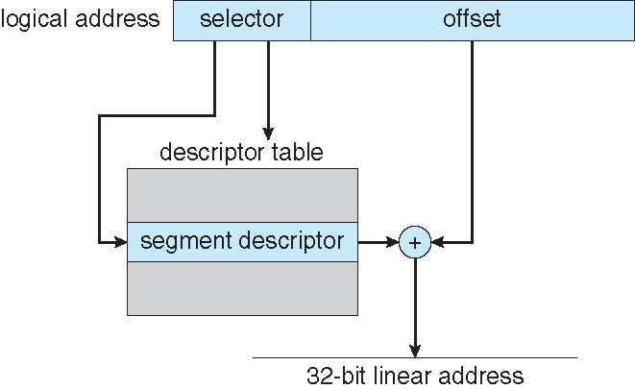

Intel IA-32 Architecture
CPU generates logical address
Selector: 16 bits
Offset: 32 bits
IA-32 Linear Address
segment base + offset
LDT or GDT
protection

Slide 5
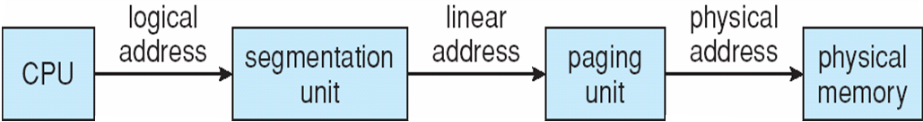
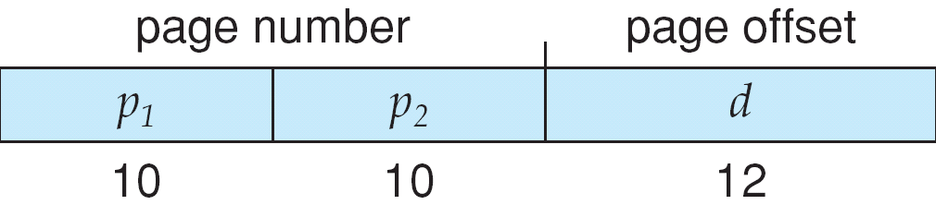
IA-32 Logical to Physical Address Translation

Slide 6
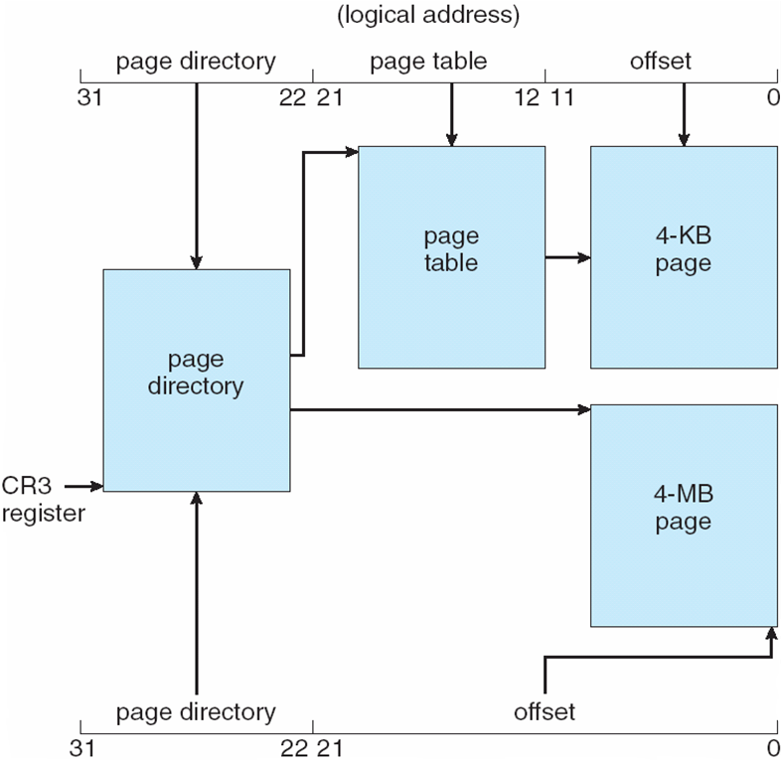
Intel IA-32 Paging Architecture
20 bits
20 bits
10
22
Page_Size = 1
4MB page

Slide 7
Intel IA-32 Page Address Extensions
page address extension (PAE), allowing 32-bit apps access to more than 4GB of memory space
More than 4 GB space
Paging went to a 3-level scheme
Top two bits refer to a page directory pointer table
Page-directory and page-table entries moved to 64-bits in size
IA-32 address space
20 + 12 = 32 2³² = 4GB
20 + 4 + 12 = 36 (PAE) 2³⁶ = 64GB
24 bits
24 bits

Slide 8
x86-64
Current generation Intel x86 architecture
64 bits is ginormous (> 16 exabytes)
In practice only implement 48 bit addressing
256 TB
Page sizes of 4 KB, 2 MB, 1 GB
Four levels of paging hierarchy
Can also use PAE so virtual addresses are 48 bits and physical addresses are 52 bits

Slide 9
ARM Architecture
Dominant mobile platform chip (Apple iOS and Google Android devices for example)
Modern, energy efficient, 32-bit CPU
4 KB and 16 KB pages
1 MB and 16 MB pages (termed sections)
One-level paging for sections, two-level for smaller pages
Two levels of TLBs
Outer level has two micro TLBs (one data, one instruction)
Inner is single main TLB
First inner is checked, on miss outers are checked, and on miss page table walk performed by CPU

Slide 10

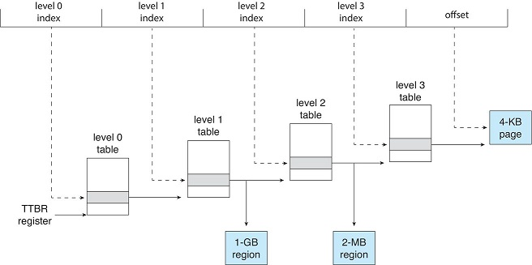
ARM Architecture
ARMv8
64 bit
48-bit used
or
or

